Slide 1
Week 11 Exercises: MRIO semantic
Glenn A. Aguilar-Hernandez
March 15, 2o22

Slide 2
Today’s agenda
Time | Activity
15.20 – 15.25 | Part 1: Introduction
15.25 – 15.30 | Question 1 & 2
15.30 – 15.40 | Review Question 1&2
15.40 – 15.50 | Question 3
15.50 – 16.05 | Review Question 3
16.05 – 16.20 | Break
16.20 – 16.25 | Part 2: Introduction
16.25 – 16.45 | Develop code
16.45 – 17.00 | Review code

Slide 3
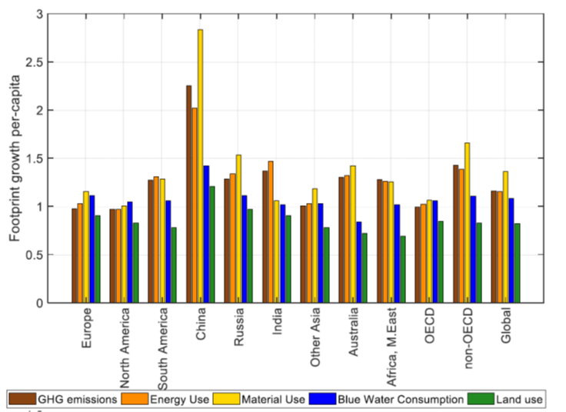
Part 1: Introduction
Figure 1. Growth in consumption-based footprints per capita between 1995 and 2011 for 11 world regions (1995 = 1) retrieved from Wood et al. (2018)

Slide 4
Review Question 1&2

Slide 5
Review Question 3
Let’s go to whiteboard!

Slide 6
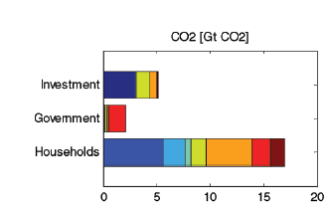
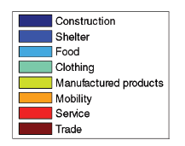
Part 2: Introduction
Figure 2. Global CO2 footprint for different consumption categories and users retrieved from Hertwich and Peters (2009)

Slide 7
Review code
Let’s go to Python!

